Slide 1
NLP & FINANCIAL CAPSTONE
Financial Sentiment Analysis with Statistical Models, Deep Learning & LLMs
PROGRAMME & INSTITUTION
Senior Data Scientist at Blend & IIITH
Graduate Capstone Research Project • Track: Applied Financial NLP
Dataset Benchmark: Financial PhraseBank (Malo et al., 2014)
PROJECT DETAILS & MENTORSHIP
Faculty Mentor / Advisor:
Gopichand Kanumolu
Bachelor of Technology, Electronics and Communications Engineering
Project Lead: Viraj Shah | Date: November 2027
Team Members: Ananthi Siva, Chanchal Sakarwar, Rajashekar Reddy Mettu, Sreedhar P Reddy
AGENDA: Problem→ Data→ Models→ Results→ Demo→ Conclusion

Slide 2
Team Introduction
Project Team
Viraj Shah
Project Lead
Ananthi Siva
Team Member
Chanchal Sakarwar
Team Member
Rajashekar Reddy Mettu
Team Member
Sreedhar P Reddy
Team Member

Slide 3
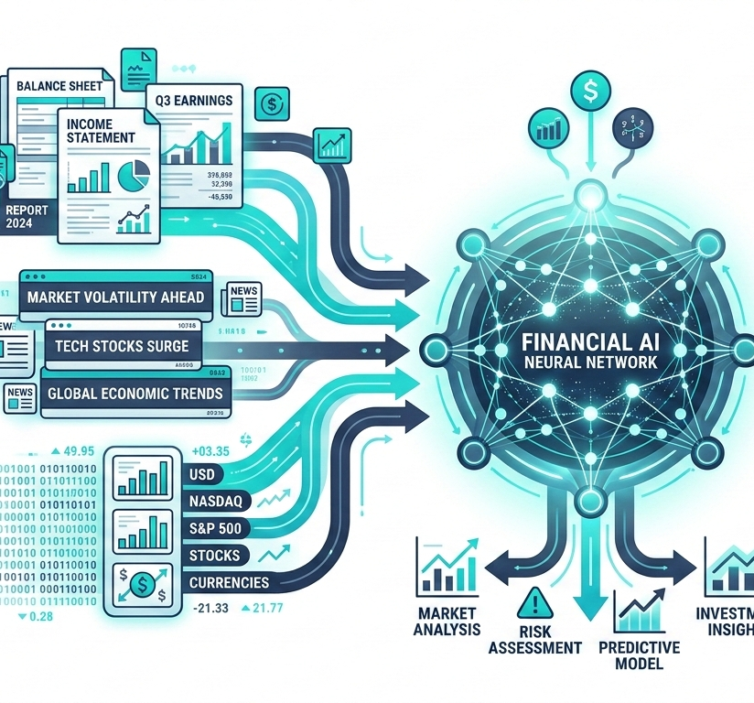
Financial Sentiment Analysis with Statistical Models, Deep Learning & LLMs
Evaluating multi-architecture NLP performance on complex domain-specific financial text
PROBLEM DEFINITION
This project investigates the application of Statistical Models, Deep Learning Based Models, and Large Language Models (LLMs) for Financial Sentiment Analysis (FSA).
We benchmark foundation LLMs including GPT-OSS-120B, GPT-OSS-20B, Qwen2.5-32B, Gemini-3.5-Flash-Lite and Nemotron-3-Ultra-550B-A55B against a domain-specific fine-tuned model (FinBERT) and classical baselines for sentence-level sentiment in financial news.
PROJECT OBJECTIVES
Target scope (Financial PhraseBank) and future work:
Sentence-level financial news (Evaluated)
Comprehensive financial reports (Future work)
Company announcements & filings (Future work)

Slide 4

Real-World Applications of Financial Sentiment AI
How financial sentiment models process unstructured market data into low-latency trading signals, earnings analysis, and enterprise risk intelligence.
ALGORITHMIC TRADING & SIGNALING
Automating event-driven signals by ingesting real-time financial news and SEC filings to support trading strategies alongside classical models (e.g. RavenPack sentiment feeds).
01
EARNINGS CALL & ANNOUNCEMENTS
Parsing executive tone and guidance during quarterly earnings calls to quantify corporate outlook and leadership sentiment shifts (e.g. S&P Capital IQ transcript scoring).
02
ENTERPRISE RISK & INTELLIGENCE
Detecting systemic market risks, credit default signals, and regulatory actions to provide portfolio managers proactive risk mitigation (e.g. Moody's Credit Sentiment).
03

Slide 5
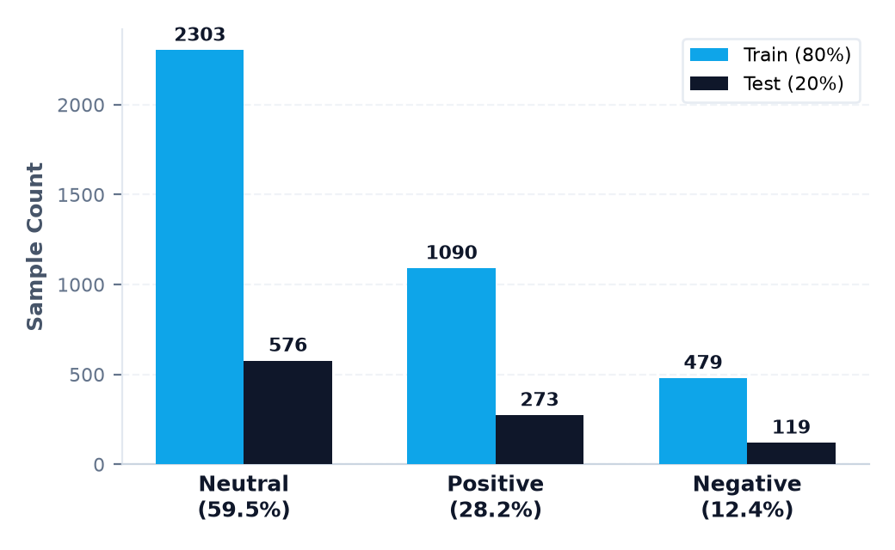
Dataset & EDA Results
Financial PhraseBank benchmark analysis, class imbalance diagnostics, and proportional stratified partitioning.
BENCHMARK SOURCE
PARTITIONING DESIGN
EDA & CLASS DIAGNOSTICS
Financial PhraseBank
Malo et al. (2014) JASIST
4,840 sentences
Agreement Subset: Sentences_50Agree (≥50% consensus). 4,846 raw rows → 4,840 clean.
Task Formulation: 3-way single-sentence sentiment classification (Positive, Neutral, Negative).
Data Scope: Concise news headlines from LexisNexis database.
Citation: Malo, Sinha, Korhonen, Wallenius & Takala (2014), JASIST.
Train & Test Partitioning
Proportional (Class-Preserving) Split
80% / 20% split ratio
Training Set (80%): 3,872 samples. Baseline vectorization, SVM/logistic fitting & few-shot context.
Test Set (20%): 968 samples. Held out strictly for zero-shot LLM & baseline inference evaluation.
Stratified Preserving: Executed via stratify=df['Sentiment'] to preserve exact class proportions.
Reproducibility: Fixed random state seed=42; test_size=0.20 for deterministic evaluation.
Class Distribution & Imbalance
Severe Neutral-skew necessitates Macro-F1 metric
Imbalance Profile: Neutral dominates at 59.5% (2,879), Positive 28.2% (1,363), Negative 12.4% (598).
Metric Selection: Accuracy is biased towards majority class; Macro-F1 gives equal weight to all classes.
Text Length Profile: Mean sentence length ~23.1 words (std 10.4); 11,248 unique tokens across financial lexicon.

Slide 6

Architecture Focus: Multi-Paradigm Comparison
Evaluating structural representations, inductive biases, and empirical trade-offs across NLP paradigms.
PARADIGM 01
PARADIGM 02
PARADIGM 03
Statistical Models
Classical feature-engineered classifiers
Deep Learning & Transformers
Sequential NNs & domain-tuned transformers
Prompted LLMs
Autoregressive foundation models
REPRESENTATION & FEATURES
N-gram TF-IDF vectorization
Sparse high-dimensional vocabulary
Handcrafted lexical weights
EMBEDDINGS & ENCODERS
Bi-LSTM: Static vectors (Word2Vec/GloVe)
BERT/FinBERT: Contextual subword tokens
Self-attention domain pre-training
INFERENCE & PROMPTING
Zero-shot & few-shot in-context learning
Autoregressive token generation
REST API endpoint orchestration
CORE ALGORITHMS
Linear SVM (High baseline accuracy)
Logistic Regression (Calibrated probs)
Random Forest (Ensemble trees)
CORE ARCHITECTURES
FinBERT (Domain fine-tuned transformer)
BERT-base (General language encoder)
Bi-LSTM & NNs (Sequential baselines)
EVALUATED FOUNDATION MODELS
GPT-OSS-120B / 20B (Open foundation)
Qwen2.5-32B (Instruction tuned)
Gemini-3.5-Flash-Lite (Multimodal API)
Nemotron-3-Ultra-550B-A55B (OpenRouter API)
⚡ Primary Trade-off
Low-latency inference: Ultra-fast (<10ms CPU) and lightweight footprint; robust baseline performance (SVM 0.78 F1), but ignores contextual syntax.
⚡ Primary Trade-off
Domain specialization: Superior semantic precision (FinBERT 0.86 F1); handles nuanced sentiment but requires GPU compute and in-domain tuning.
⚡ Primary Trade-off
Zero-shot flexibility: Strong adaptivity without training, but higher API latency/cost and lower accuracy (0.72 F1) than fine-tuned models.

Slide 7
Evaluation & Performance Comparison
Empirical benchmark across Statistical Baselines, Deep Learning Encoders, and Prompted LLMs on Financial PhraseBank
METHODOLOGY AUDIT & KEY INSIGHTS
COMPREHENSIVE PERFORMANCE MATRIX (Test Set N=968 | Financial PhraseBank 50%-Agree)
⚠ LLM Prompt Invariance & Precision Drop
Identical Zero/Few-Shot Scores: GPT-OSS-120b yielded 0.72 Acc / 0.60 F1 in both setups.
Precision Anomaly: Label-parsing bias under-predicts minority negative sentiment.
Model
Group
Setting
Acc
Macro-F1
W-F1
Latency
FinBERT TOP
Deep Learning
Fine-tuned
0.86
0.86
0.86
[to fill]
BERT / Bi-LSTM / NN
Deep Learning
Train split tuned
0.82
0.81
0.82
[to fill]
🔍 FinBERT Checkpoint & Pre-training Caveat
ProsusAI/FinBERT Data Overlap: Public checkpoint trained on Financial PhraseBank.
Held-Out Fine-Tuning: 80% train split achieves 0.82 F1, beating general LLMs.
Linear SVM / LogReg
Statistical
TF-IDF (1,2-gram)
0.78
0.77
0.78
<5ms
Nemotron-3-Ultra-550B
LLM
Zero-shot API
0.77
0.72
0.73
1.45s
GPT-OSS-120b
LLM
Zero-shot direct API
0.75
0.70
0.71
0.62s
✓ Architectural Trade-offs & Viability
Domain Tuning > Size: Specialized encoder (0.86) surpasses foundation models.
Latency Efficiency: Linear SVM executes in <5ms CPU latency.
Gemini-3.5-Flash-Lite
LLM
Zero-shot direct API
0.75
0.70
0.71
2.01s
Qwen2.5-32B
LLM
Zero-shot direct API
0.60
0.25
0.45
0.03s
*Note: Latency values marked '[to fill]' require empirical profiling on designated hardware infrastructure.

Slide 8
Demo Section: Interactive Testing Applications
Three dedicated Streamlit applications for evaluating Statistical Baselines, Deep Learning, and LLM Inference Paradigms
STATISTICAL DEMO 01
DEEP LEARNING DEMO 02
LLM DEMO 03
Statistical Models UI
Baseline ML model inferencing environment
Deep Learning Based Models
Domain Fine-Tuned Transformer Models
Large Language Models (LLMs)
Open-weight (GPT-OSS, Qwen) and proprietary (Gemini) LLMs
KEY TARGETS & FEATURES
Models: Logistic Regression, Linear SVM, Random Forest
Vectorization: TF-IDF (1,2-grams vocabulary)
Inference: Lightweight CPU execution & instant scoring
Dataset: Financial PhraseBank (N=968 test split)
Output: Class probability & confidence scores
KEY TARGETS & FEATURES
DL Models: FinBERT, BERT-base, Bi-LSTM, Dense MLP
Paradigm: Fine-tuned task-specific pre-training
Performance: 0.86 F1 (FinBERT), 0.81 F1 (BERT-base)
Dataset: Financial PhraseBank corpus
Evaluation: Superior semantic precision on financial lexicon
KEY TARGETS & FEATURES
Models: GPT-OSS-120B, GPT-OSS-20B, Qwen2.5-32B, Gemini-3.5-Flash-Lite, Nemotron-3-Ultra-550B-A55B
Paradigm: Zero-Shot & Few-Shot Prompting
Flexibility: High textual adaptivity across prompt variants
Integration: REST API Endpoint Orchestration
Output: Multi-prompt structured predictions
🔗 Open Live Demo
🔗 Open Live Demo
🔗 Open Live Demo

Slide 9
Conclusion, Research Limitations & Future Work
BENCHMARK TAKEAWAYS
METHODOLOGICAL CONSTRAINTS
RECOMMENDED NEXT STEPS
Conclusions & Evidence
Research Limitations
Future Work & Directions
Comparative Ranking
FinBERT 0.86 F1 > SVM 0.77 > GPT-OSS 0.60
Task-specific adaptation yields decisive gains over zero/few-shot general LLM prompting on domain text.
Single Dataset & Sentence Scope: Evaluated only on Financial PhraseBank sentences, omitting multi-page filings.
Class Imbalance: Heavy neutral sentiment skew in financial news distorts macro vs weighted metrics.
Label Noise & Threshold: 50% agreement threshold includes annotator ambiguity and subjective phrasing.
Prompt Variance: Single-run evaluations; LLMs exhibit non-determinism and prompt sensitivity.
Potential Training Overlap: Public FinBERT pre-training corpus may overlap benchmark test samples.
Unmeasured Cost & Latency: Inference latency and hardware/API costs were not empirically quantified.
Multi-Dataset Benchmarks: Evaluate on diverse corpora including FiQA and SemEval-2017 Task 5.
Long-Document Contexts: Test performance on full-length corporate filings (10-K, 10-Q) and earnings calls.
Fine-Tuned & PEFT LLMs: Apply LoRA/QLoRA parameter-efficient fine-tuning on open-weight LLMs.
Confidence & Calibration: Implement temperature/Platt scaling to resolve probability miscalibration.
Cost & Latency Audits: Systematically profile token latency, compute FLOPs, and API operational expenses.
FinBERT Pre-training & Tuning
FinBERT: BERT further pre-trained on financial text (Reuters TRC2) and fine-tuned for sentiment classification (Financial PhraseBank).
Prompt Tuning Hypothesis
Hypothesis: General LLMs may need dedicated prompt tuning or instruction formatting to reach FinBERT accuracy; untested in this study.

Slide 10
DISCUSSION
Questions & Discussion
Open floor for inquiries, methodology critique, and project collaboration.
Project Repository & Team Inquiries
GitHub: github.com/v863/Capstone-Project-in-Financial-Sentiment-Analysis.git
Project Lead: Viraj Shah
Contributors: Ananthi Siva, Chanchal Sakarwar, Rajashekar Reddy Mettu, Sreedhar P Reddy
Artifacts: Checkpoints, evaluation scripts, and live demo configurations available in repo.

Slide 11
Appendix: Model Architecture & Identifier Reference
Standardized model registry mapping display names to exact versioned model IDs and execution environments
Display Name | Exact Model Identifier | Provider / Architecture | Inference Paradigm | Execution Environment
FinBERT | ProsusAI/finbert | Hugging Face / BERT | Task Fine-Tuned (Domain) | Local PyTorch / HF Pipeline
GPT-OSS-120B | openai/gpt-oss-120b | OpenAI / OSS Foundation | Zero-Shot & Few-Shot Prompting | REST API / Distributed vLLM
GPT-OSS-20B | openai/gpt-oss-20b | OpenAI / OSS Foundation | Zero-Shot & Few-Shot Prompting | REST API / Dedicated GPU Node
Qwen2.5-32B | Qwen/Qwen2.5-32B-Instruct | Alibaba Cloud / Transformer | Zero-Shot & Few-Shot Prompting | vLLM API Endpoint
Gemini-3.5-Flash-Lite | google/gemini-3.5-flash-lite | Google Cloud / Multimodal LLM | Zero-Shot & Few-Shot Prompting | Google Cloud Vertex AI API
Nemotron-3-Ultra | nvidia/nemotron-3-ultra-550b-a55b:free | NVIDIA / Sparse MoE | Zero-Shot & Few-Shot Prompting | TensorRT-LLM / Multi-GPU vLLM

